Slide 1

Usama Baig (Team Lead) | Technical Research
Muhammad Mahad | Technical Research
Khalid . | Technical Research
A Deep Learning Model to detect breast cancer metastasis
Advisor: Dr. M. Shahzad
Co-Advisor: Dr. Qaiser Riaz

Slide 2
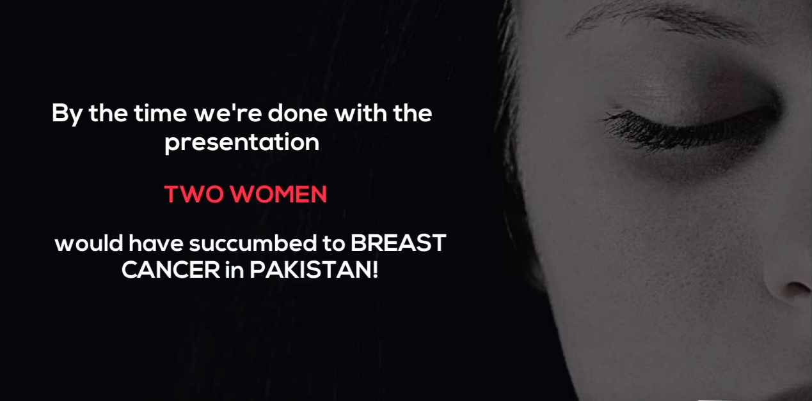

Slide 3
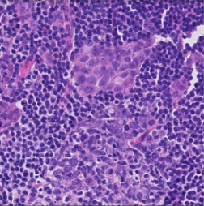
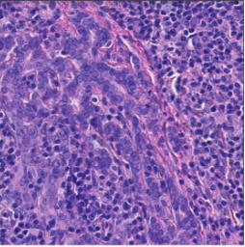
Can you tell which one contains TUMOR?

Slide 4


Impact on Pathologist’s Workflow
Hard to scan whole image (WSI) manually
Up to 30 hours per Slide
Classical computing methods are NOT ROBUST
Automated
Up to 0.5 hours per Slide
ROBUST to staining methods
Notes:
Just use Logo here to
REASONS
Early diagnosis decreases mortality rate

Slide 5
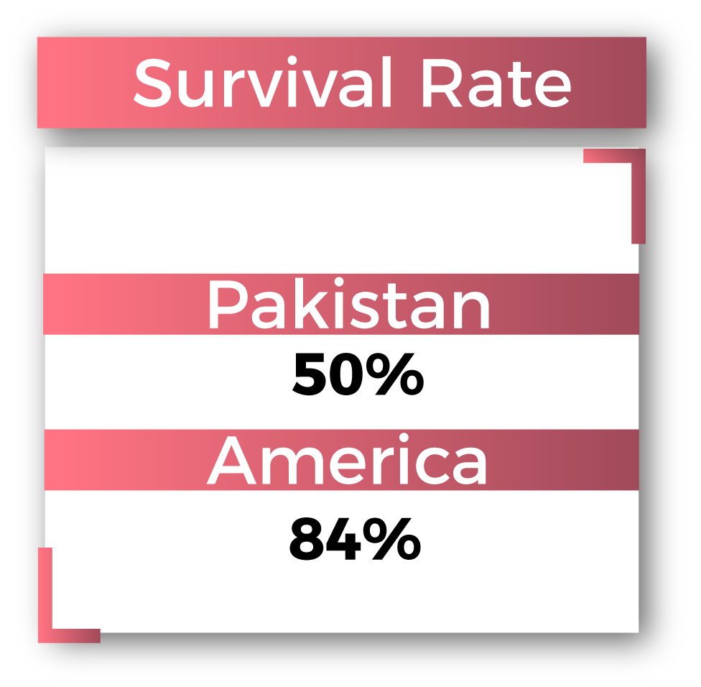
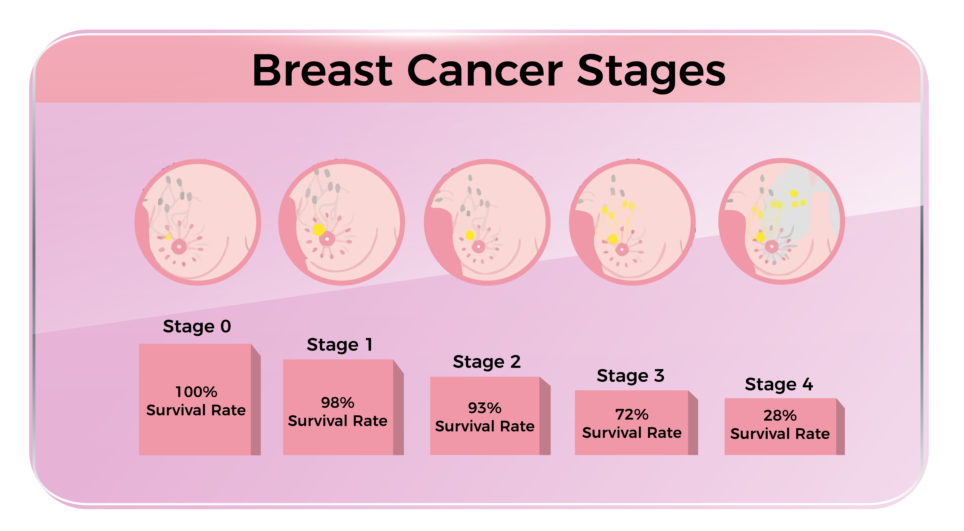
Problem
https://www.thenews.com.pk/print/375948-over-83-000-breast-cancer-cases-in-pakistan-every-year/

Slide 6
Proposed Solution

Slide 7

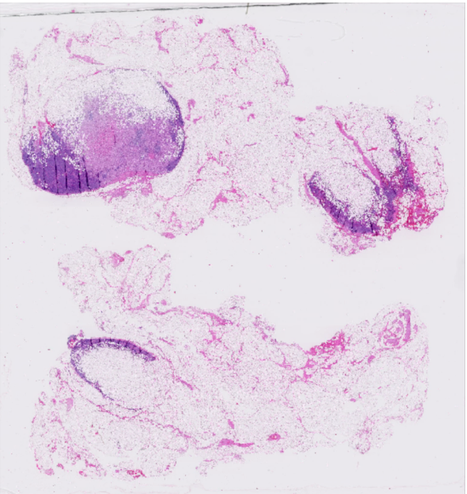
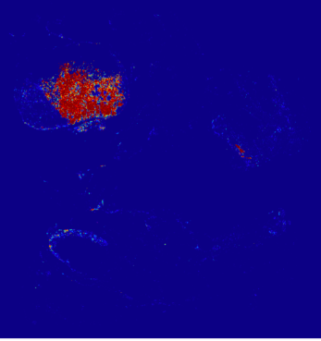


Our Solution
We propose Catanet -
An Artificial Intelligence (AI) based classification pipeline
Localization of TUMOR
Cancer Stage Determination
Classification of WSI
Notes:
Just use Logo here to

Slide 8
Market Research

Slide 9

FACTS (Pakistan)
10.2 Million vulnerable
90 Thousand diagnosed
every year
40+ Thousand deaths
every year
https://arxiv.org/abs/1606.05718
1 in 9 Women in PAKISTAN suffer from Breast Cancer
25/1 Lac Mortality Rate
Notes:
REASONS

Slide 10
Interest from Industry
Dr. Nimra Nadeem (Oncologist, SKMH&RC) - 10.21 % diagnosis accuracy at Stage-1 - No system for organized data collection
Dr. Zonaira Rathore (Pathologist, Chughtai Labs) -70% decisions are based on lab tests -3,00,000+ biopsies every year
Dr. Shehnaz (Head of Diagnostic at Noori Hostpital)
Dr. Raja Nasir (Shifa Intl. Hospital)
Notes:
All you need is a whole slide image scanner
Dr. Nimra Nadeem Says no system for organized collection of data

Slide 11
Market Analysis
LABORATORY | TOTAL BIOPSIES | BREAST CANCER BIOPSIES (PERCENTAGE) | TOTAL NUMBER OF BREAST CANCER BIOPSIES
CITI LAB | 21,500 | 35% | 7,525
Chughtai LAB | 26,000 | 50% | 13,000
Shaukat Khanum Hospital LAB | 23,000 | 40% | 9,200
Shifa International Hospital LAB | 19700 | 35% | 6,895
Maroof International Hospital LAB | 15,000 | 33% | 4,950
Kulsom International Hospital LAB | 17,000 | 38% | 6,460
Notes:
They pay almost 1000 per biopsy to the pathologist

Slide 12
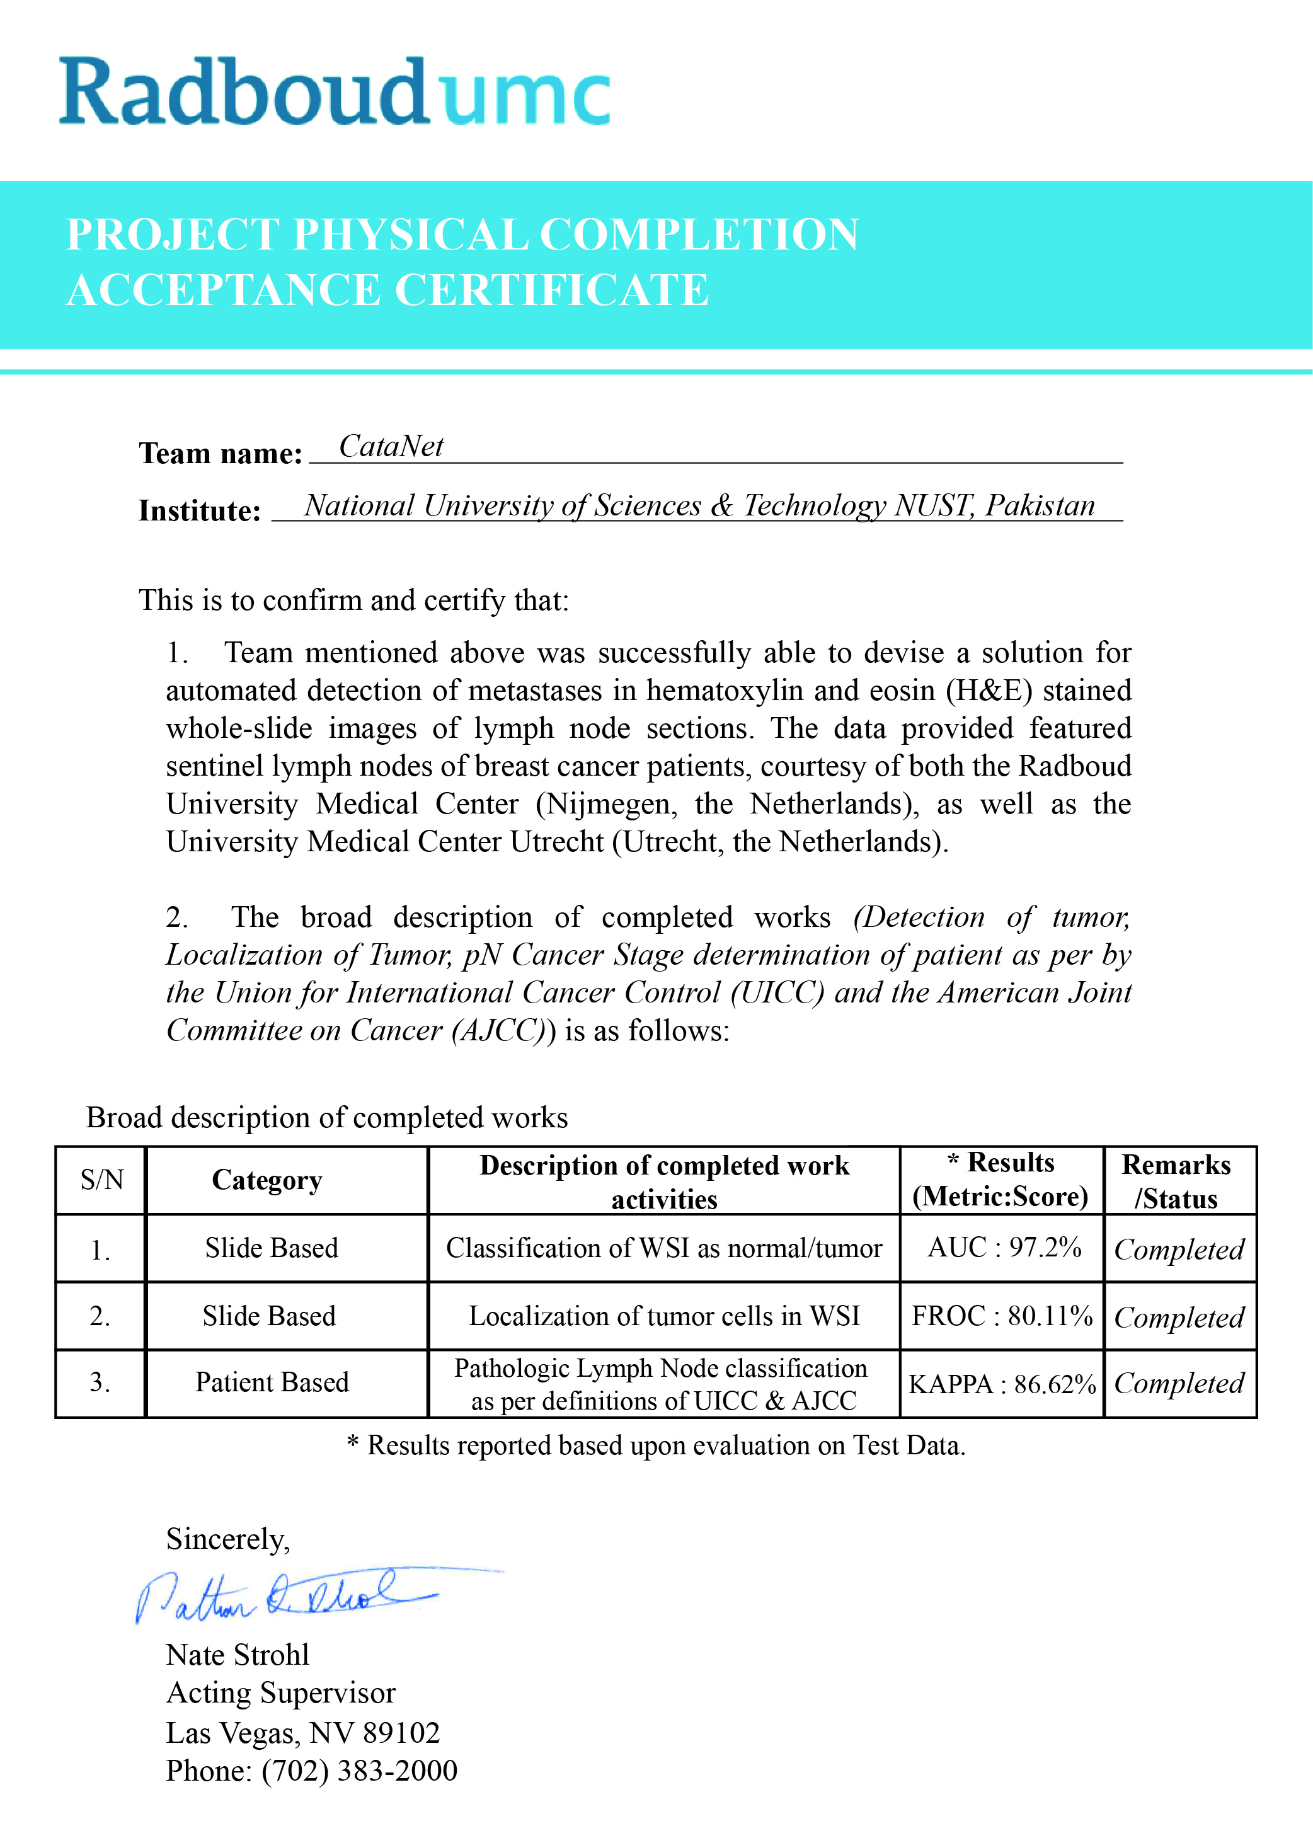
Interest from International Community
Radboud University Medical Center,
Nijmegon, the Netherlands.
University Medical Center,
Utrecht, the Netherlands.
National Center for Biotechnology Information
(NCBI), United States National Library
of Medicine.
Notes:
NCBI add

Slide 13
Technical working

Slide 14



Region of Interest (ROI) detection with Image Procession
Training Phase
1
2
3
Region of Interest (ROI) detection with Image Procession
Train Deep ConvNet for tile-based classification
Training Data Construction
Testing Phase
1
Building Tumor Probability heatmaps using trained model
2
3
4
Determine cancer metastasis stage
Slide-based classification
Localization of tumor regions

Slide 15
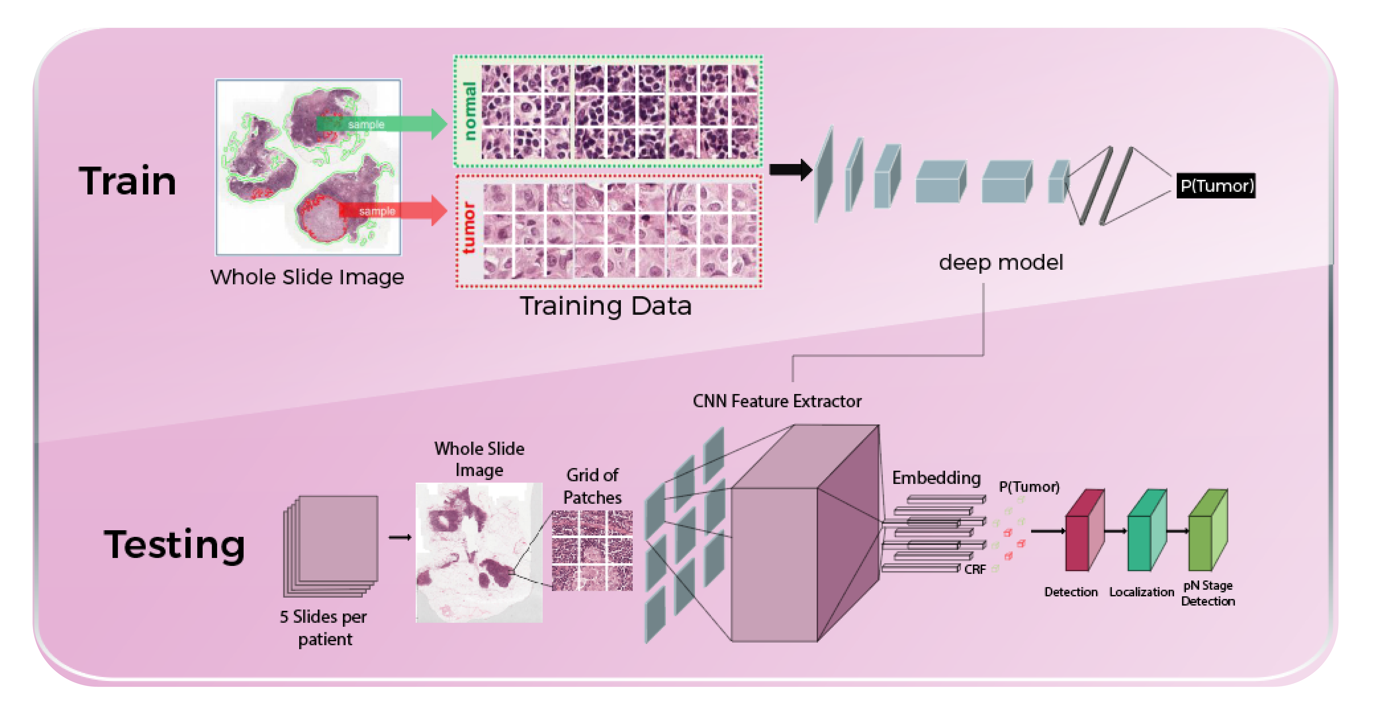
Our pipeline

Slide 16
Results
Metric | CataNet | Team Harvard | Human
Detection | 97.46 % | 97.02 % | 97 %
Localization | 85.92 % | 86.0 % | 73.34 %
Stage Prediction | 87.81 % | - | 25 %

Slide 17
Novelty

Slide 18
VALUE PROPOSITION
CataNet helps pathologists
who want to scan whole slide images for cancer detection
by
detecting, localizing and predicting the cancer metastasis stage with more accuracy
and
reduced time complexity from 30 hours to 0.5 hours.

Slide 19
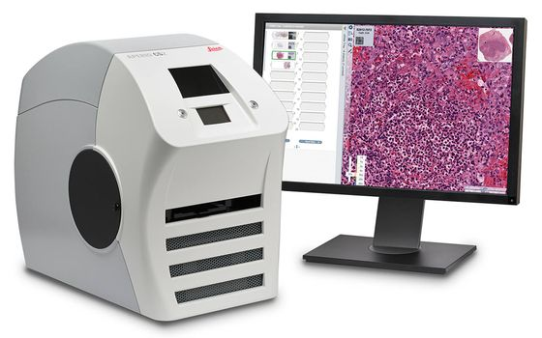
Why Catanet?
Fits perfectly in the pathologist’s diagnosis pipeline
Minimal Hardware Requirements - Digital Slide Scanner - Working Computer
Minimal Training Required
Mass-deployment possible -Collaboration with Government and Private Labs and diagnostic centres -Collaboration with Medical Facilities having MoU with NUST
Notes:
All you need is a whole slide image scanner

Slide 20
CataNet
Competitive Advantage
Pathologists
Manual scan by pathologist
Error prone judgment
Time consuming
Employs State-of-the-art AI based algorithms for automatic diagnosis
Increases accuracy by 300+%
Reduced time complexity
Reduce surgery rate by 30%
First Nationwide organized Data Collection
Notes:
Our competirors are pathologist

Slide 21
Estimates of Financials & Timeline

Slide 22
Timeline
Activity | Duration | Status
Domain Research | 8 weeks | Complete
Data Gathering and Pre-processing | 3 weeks | Complete
Development | 16 weeks | Complete
In house Testing | 3 weeks | Complete
Beta Testing | 5 weeks | Partially Complete
Deployment | Commencement after approval from Regulatory bodies and Copyright grant | Incomplete

Slide 23
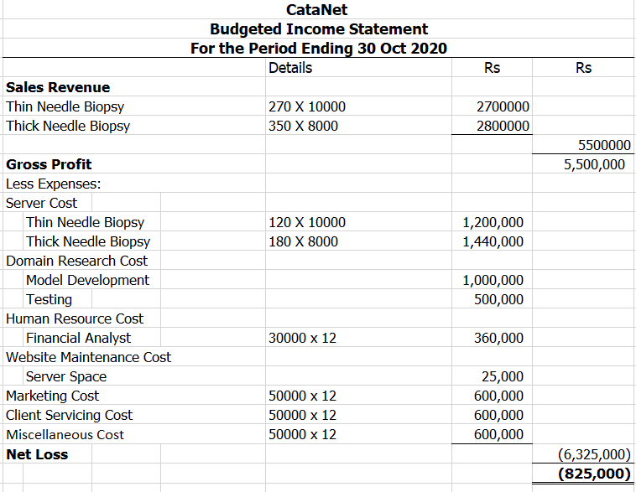
Estimate of Financials

Slide 24
Support Required from Stakeholders
Professional assistance from a histopathologist.
Assistance from health regulatory bodies regarding regulations for developing and deploying health systems.
Use Cases data for testing
Funding

Slide 25
Future Direction
Deployment of the proposed solution at micro and macro level
Increasing Revenue Streams
Frozen Specimen
Prostate cancer
Lung cancer
Brain tumor.
Establishment of startup that provides innovative approaches for solving medical problems using AI.
Gene Therapy
Dividend Revenue
Medical Consultancy
Notes:
Reaching for the bigger market

Slide 26
Questions/ advice?
Notes:
To add:
Financials
Certificate

